Slide 1


Joint Strategic Planning Session
Albemarle County Board of Supervisors & Albemarle County School Board
July 25, 2013

Slide 2
Purpose
Consider existing and future possibilities for alignment between our Strategic Plans
Explore the meaning of “thriving” and “excellent” in the context of education for all County residents
Build on shared understanding and productive working relationships

Slide 3
School Division
Strategic Plan Overview

Slide 4
General Government
Strategic Plan Overview

Slide 5
Comparison of Vision, Mission, Values
What strikes you?
Our Vision
All learners believe in their power to embrace learning, to excel, and to own their future.
Our Mission
The core purpose of Albemarle County Public Schools is to establish a community of learners and learning, through relationships, relevance, and rigor, one student at a time.
Our Core Values
Excellence
We believe in meaningful learning that stretches people to the frontiers and boundaries of their abilities.
Young People
We believe young people deserve the best we have to offer. Each individual child is capable and has the right to safety, mutual respect, and learning.
Community
We believe in our collective responsibility to work together in a cooperative effort to achieve common goals by building communities of practice, establishing a high quality learning community, and listening to the community.
Respect
We believe in treating all individuals with honor and dignity.
Our Vision
A thriving County, anchored by a strong economy and excellent education system, that honors its rural heritage, scenic beauty and natural and historic resources while fostering attractive and vibrant communities.
Our Mission
To enhance the well-being and quality of life for all citizens through the provision of the highest level of public service consistent with the prudent use of public funds.
Our Core Values
Integrity
We value our customers and co-workers by always providing honest and fair treatment.
Innovation
We embrace creativity and positive change.
Stewardship
We honor our role as stewards of the public trust by managing our natural, human and financial resources respectfully and responsibly.
Learning
We encourage and support lifelong learning, and personal and professional growth.

Slide 6
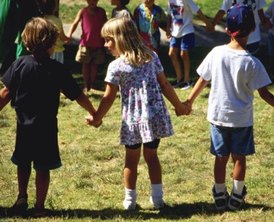




Thriving and Excellent Education
Breakout Session 1
What does “thriving” mean for education?
  What does it look like?
  How do you describe it?
  What are the dimensions?
  Where might the County already be “thriving”?
What is “excellent education” for all County residents?
  What are the indicators for excellent education?
  How would we know we have achieved it?

Slide 7
Breakout Session 1
Group 1
Scottsville and Rivanna
Mr. Koleszar
Mr. Craddock
Mr. Boyd
Mr. Buyaki
Group 2
Jack Jouett and White Hall
Mr. Rooker
Group 3
Rio, Samuel Miller, At-Large
Mr. Thomas
Ms. McKeel
Ms. Mallek
Ms. Massie Mouly
Ms. Moynihan
Mr. Snow
Mr. Gallaway

Slide 8
Break – 10 Minutes

Slide 9
Goal Group 1 Representatives
Budget
Police
Facilities
Education
Social Services
Strategic Planning
General Government | School Division
Lori Allshouse Mike Culp Pamela Dumas John Freeman Miller Stoddard | Melissa Anderson Debora Collins Josh Davis Matthew Haas

Slide 10
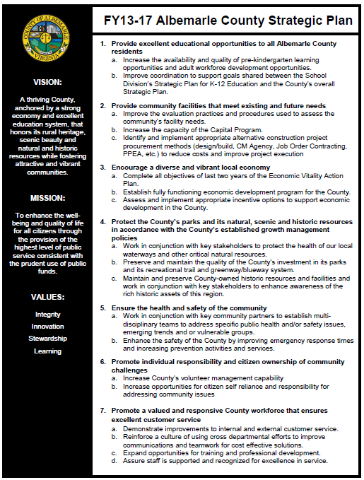
Goal 1, Objective a
Pre-K Focus
Objective a:
Increase the availability and quality of pre-kindergarten learning opportunities and adult workforce development opportunities.

Slide 11



Pre-K Collaboration
Highlights
Current capacity
Outputs and outcomes
Activity of goal group
Return on investment

Slide 12
Goal 1, Objective a & Goal 3
Objective a:
Increase the availability and quality of pre-kindergarten learning opportunities and adult workforce development opportunities.
Goal 3
Encourage a diverse and vibrant local economy.

Slide 13

Workforce Focus
Highlights
Document current regional workforce training resources
Work with local businesses to identify resource gaps
Focus on building employment pipeline for target industries
Partner with other stakeholders on PVCC Workforce Advisory Council
Support school/community programs like Tech Tour and VA Bio STEM-H Summit

Slide 14
Goal 1 - Objective b
Objective b:
Improve coordination to support goals shared between the School Division’s Strategic Plan for K-12 Education and the County’s overall Strategic Plan.

Slide 15

Crosswalk Process

Slide 16
Police and Schools
School Resource Officer at Walton
School/Gov Career Network System
Safe Schools Healthy Students
Sustainability
Connecting Employees and School Career Counselors
Fiscal Management
Regular Collaboration on Process Improvements
Visits to Schools and Student Participation in Police Explorer Post
Crime Protection through Environmental Design (CPTED) Techniques
Improved Coordination

Slide 17
Opportunities for Alignment
“Looking broadly, how else might we improve coordination to support our strategic goals in the future?”

Slide 18
Wrap-up and Next Steps

